Slide 1

Project:
Cafeteria Management
System
Client:
Group:
T-RISE

Slide 2
Project Overview:
System that can manage the cafeteria
Online facility to place orders
Notification system to notify user when order
is ready for collection
Set user limits
View history of orders
Send bills to finance department
Keeping track of inventory/stock
Predictions of stock needed for the next week
Pluggable options of payment

Slide 3
Users of the System
Super User
Sets default limits
Branding the System
Global access
Cafeteria Manager
Adding menu items
Editing menu items and prices
Cashier
See orders
Process purchases
Add daily specials

Slide 4
Users of the System
Resolve Admin
Only access to view list of information of registered users and finance reports
Registered Employee
View Profile
Edit profile
Place orders
View balance / print report

Slide 5
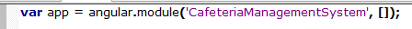
Technologies
HTML
JavaScript together with angularJS
Angular will help with modularization and
dependency injection
CSS together with Bootstrap (CSS library)
PHP together with mySQL
Apache Server
Phone Gap – to convert webpage into an
application for multiple platforms

Slide 6
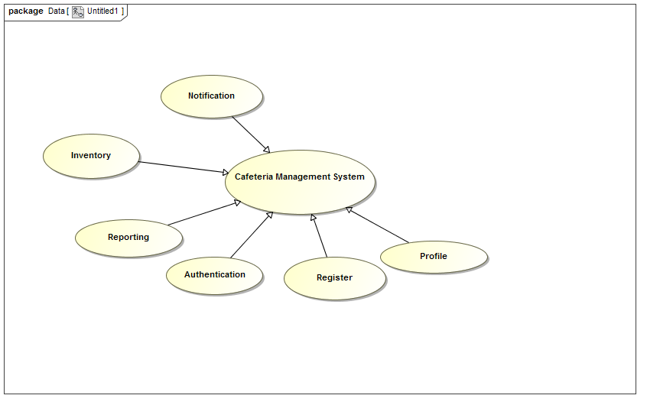
CMS use case

Slide 7
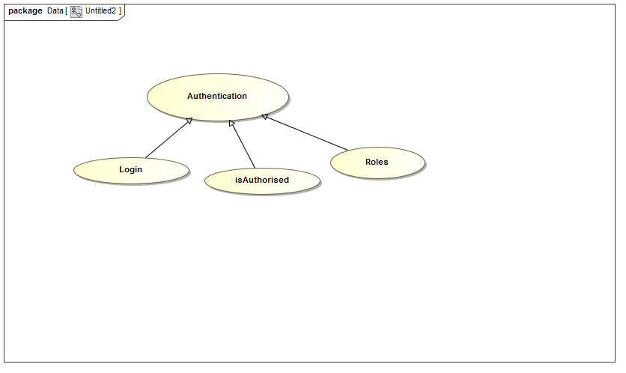
USE CASE - AUTHENTICATION

Slide 8
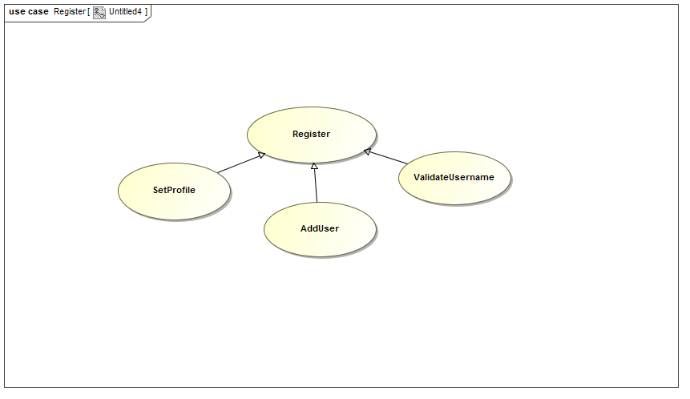
USE CASE - REGISTER

Slide 9
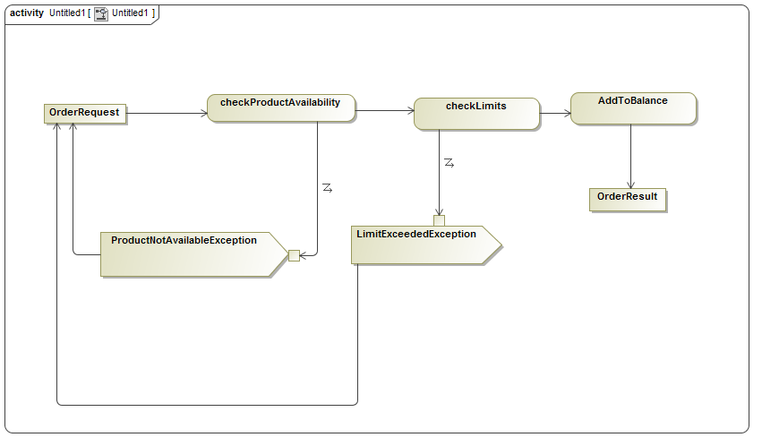
Place order activity diagram

Slide 10
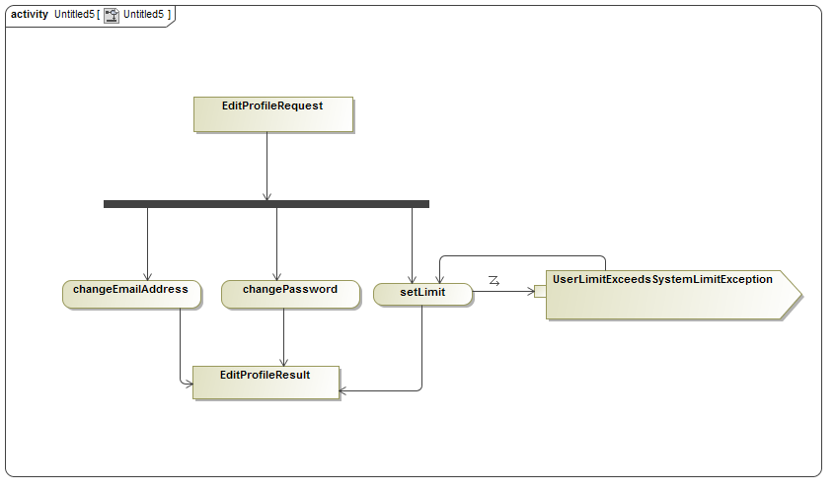
EDIT PROFILE activity diagram

Slide 11
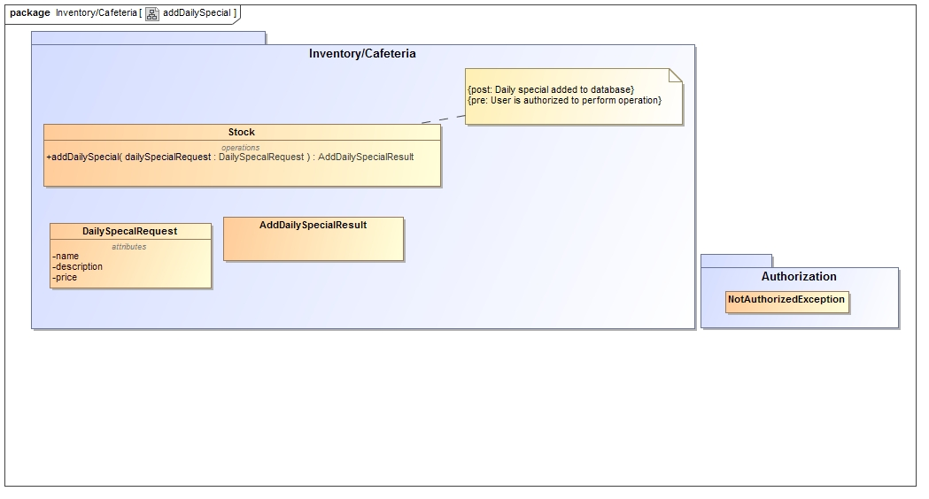
Service contract – add daily special

Slide 12
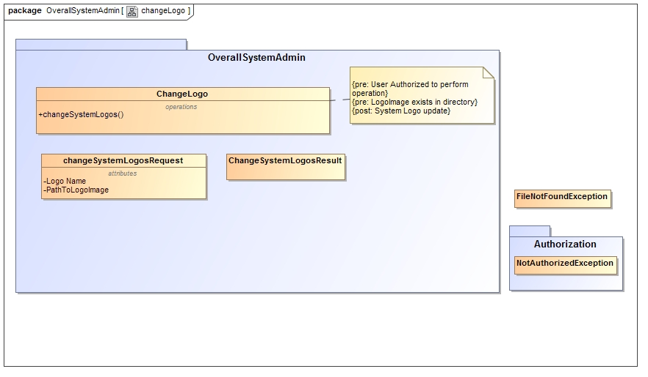
Service contract – Change logo

Slide 13
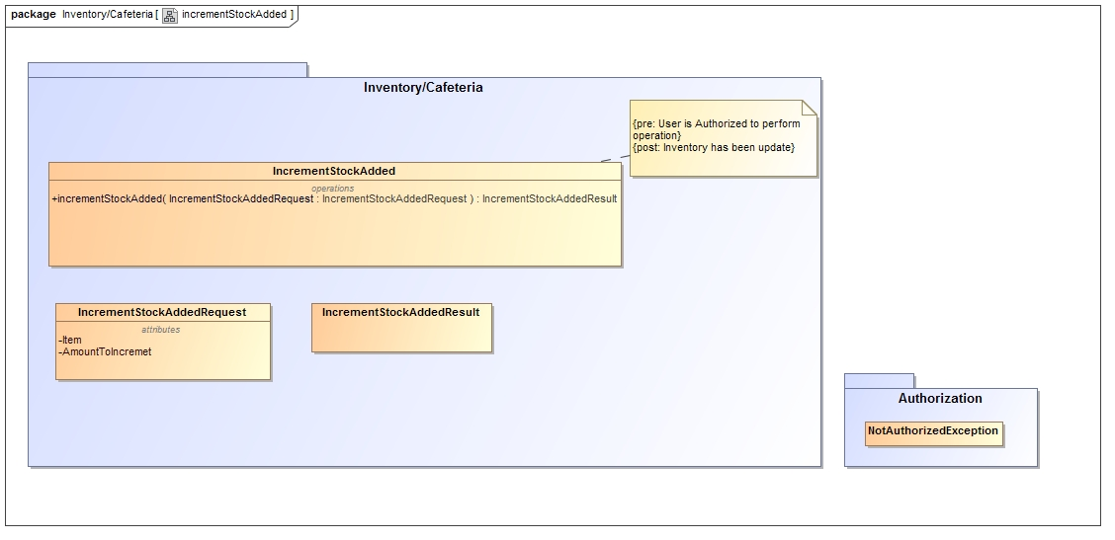
Service contract – Increment stock

